Slide 1
Theory of Automata
Lecture # 11
Imtiaz Ahmed
sites.google.com/site/kiuskardu

Slide 2
Method2 (Concatenation of two FAs)
Using the FAs corresponding to r1 and r2, an FA can be built, corresponding to r1r2

Slide 3
Let FA3 be an FA corresponding to r1r2
Then the initial state of FA3 must correspond to the initial state of FA1and the final state of FA3 must correspond to the final state of FA2.

Slide 4
Since the language corresponding to r1r2 is the concatenation of corresponding languages L1 and L2, consists of the strings obtained, concatenating the strings of L1 to those of L2 , therefore
  The moment a final state of first FA is entered, the possibility of the initial state of second FA will be included as well.

Slide 5
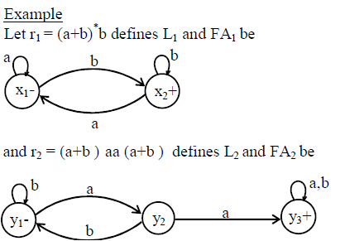

Slide 6
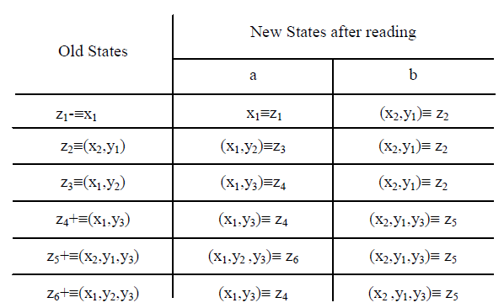
Transition Table

Slide 7
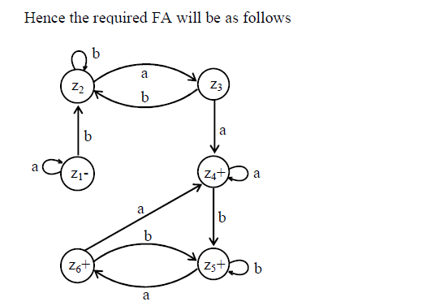
FA3

Slide 8
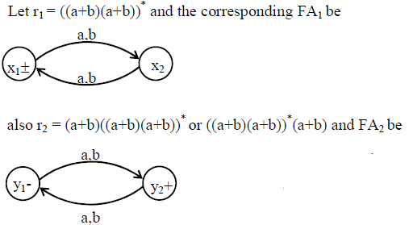
Example 2

Slide 9
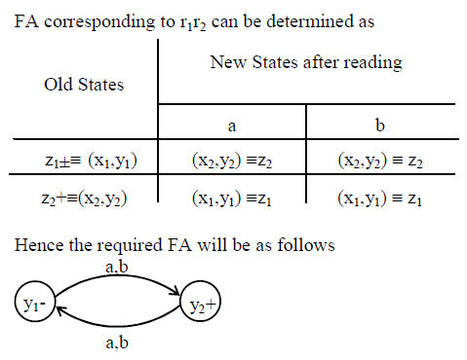
Example 2 (Contd..)

Slide 10



